Slide 1
The Booting Process
Operating System
7 - March – 2016
Notes:
Boot is short for bootstrap, a reference to the old adage, "Pull yourself up by the bootstraps," which means to start something from the very beginning.

Slide 2
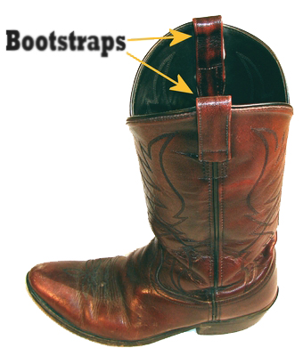
BOOT
Boot is short for bootstrap, a reference to the old adage, "Pull yourself up by the bootstraps," which means to start something from the very beginning.

Slide 3
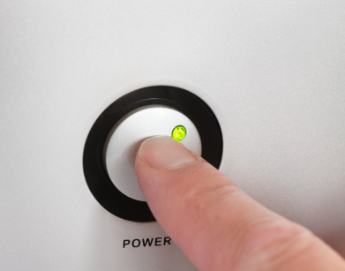
Pressing the power button!
Notes:
1- activate the PSU (power supply)
2- 0 means no current or no power
1 means current or power
3- PSU send power_good signal to the BIOS
And that is the first thing the BIOS dose, it checks that the power works correctly
4- start supplying power to the rest of the system

Slide 4
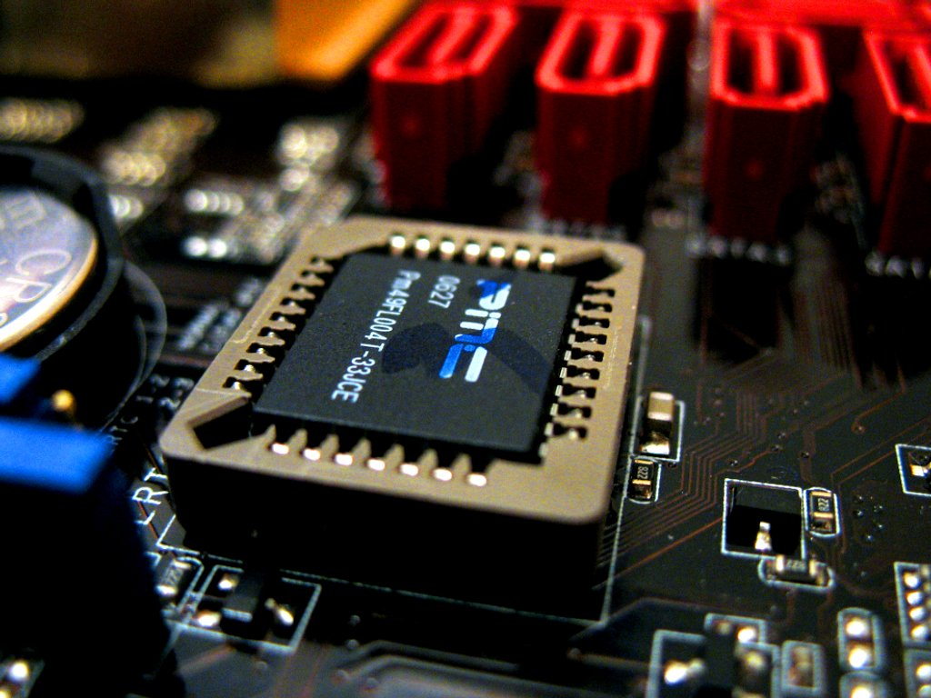
Basic Input Output System “BIOS”
Notes:
BIOS is ROM chip
The four main functions of a PC BIOS
POST - Test the computer hardware and make sure no errors exist before loading the operating system. Additional information on the POST can be found on our POST and Beep Codes page.
Bootstrap Loader - Locate the operating system. If a capable operating system is located, the BIOS will pass control to it.
BIOS drivers - Low level drivers that give the computer basic operational control over your computer's hardware.
BIOS or CMOS Setup - Configuration program that allows you to configure hardware settings including system settings such as computer passwords, time, and date.
The BIOS then needs to find an OS. Based on the boot order that you set in the BIOS Setup, the BIOS will execute Interrupt (INT) 0x19 to attempt to find a bootable device.

Slide 5
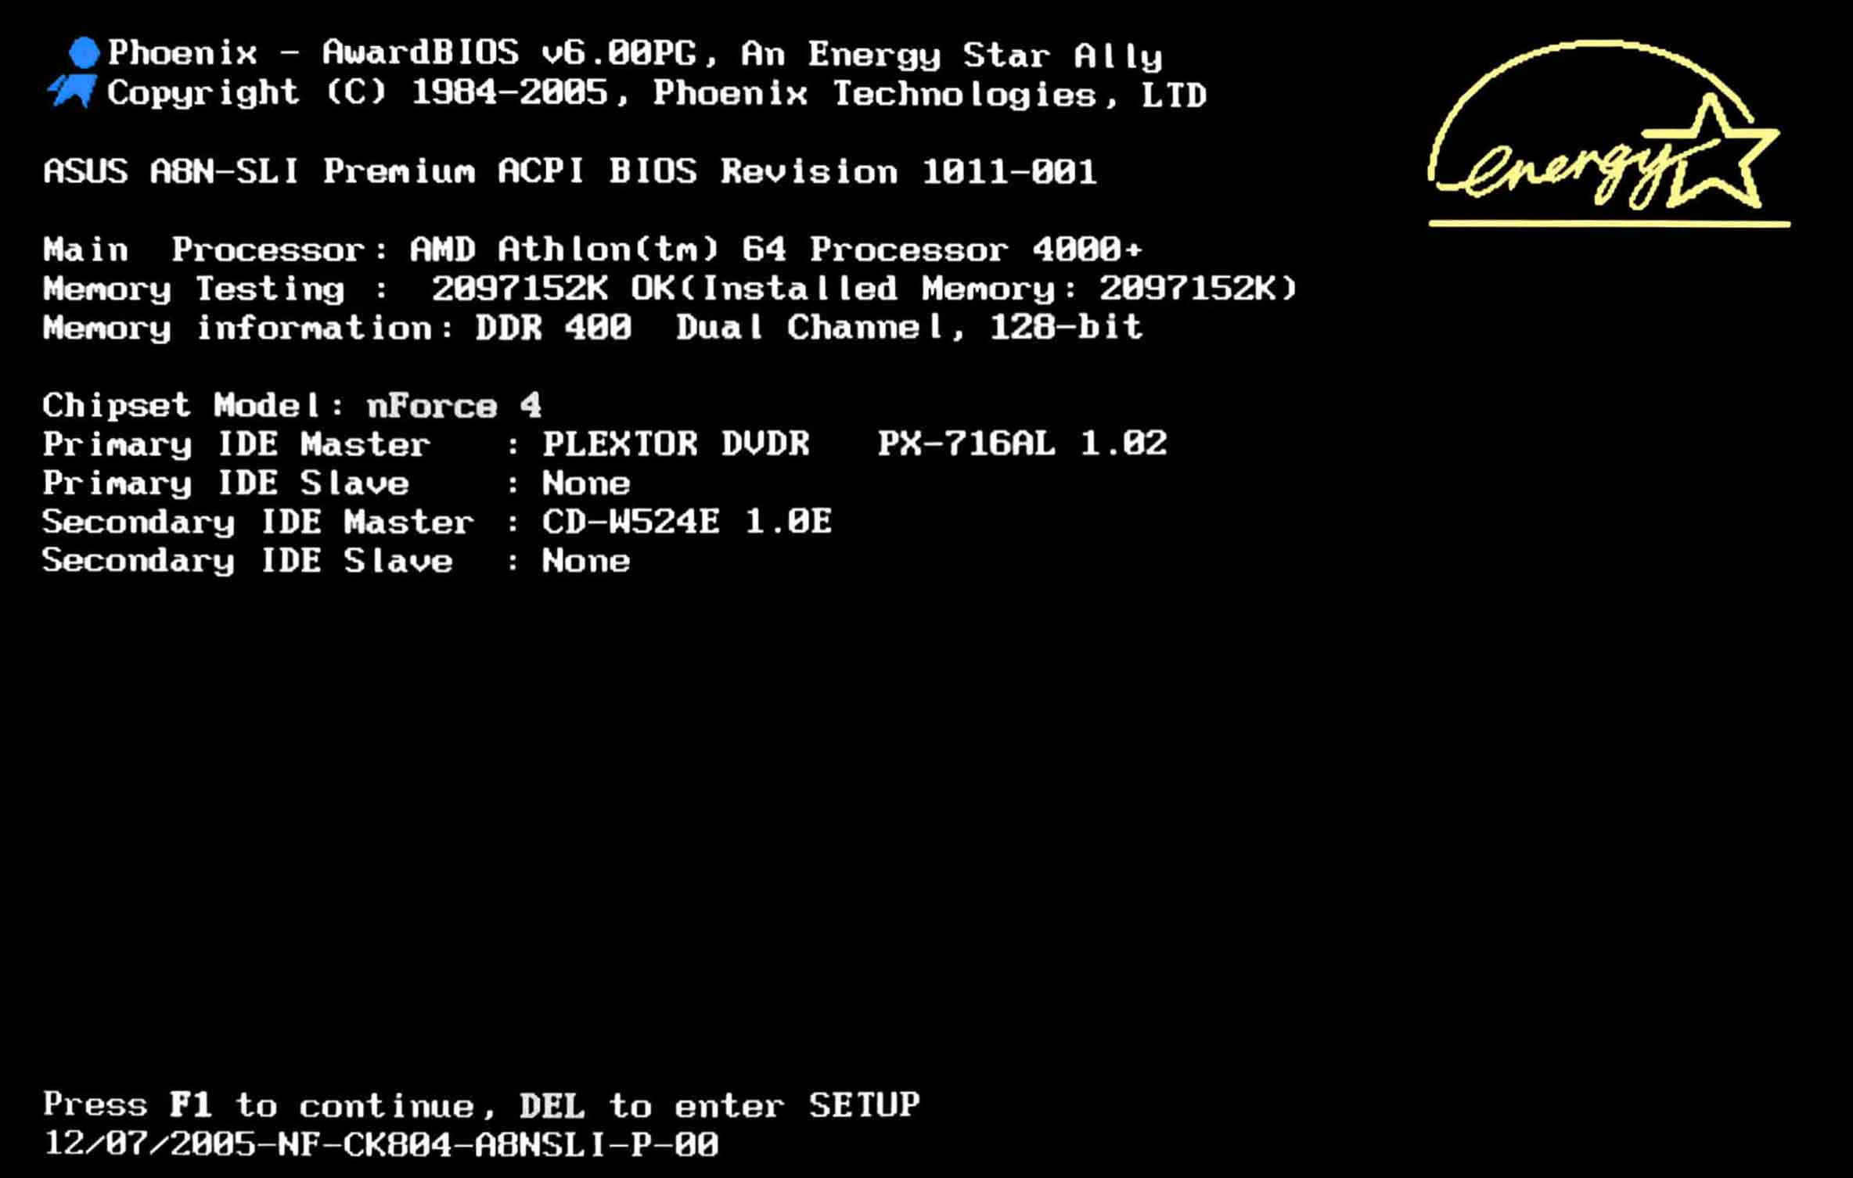
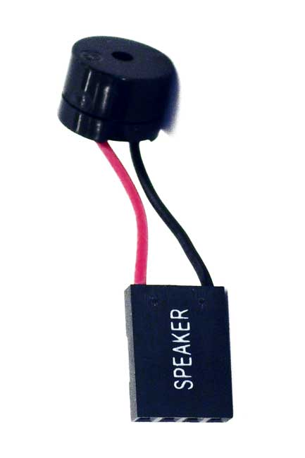
BIOS POST “power on self test”
Notes:
BIOS POST
When the BIOS recieves this "power_good" signal, the BIOS begins initializing a process called POST (Power On Self Test). The POST then tests to insure there is good amount of power being supplied, the devices installed (such as keyboard, mouse, USB, serial ports, etc.), and insures the memory is good (By testing for memory corruption).
The POST then gives control to the BIOS. The POST loads the BIOS at the end of memory (Might be 0xFFFFF0) and puts a jump instruction at the first byte in memory.
The processors Instruction Pointer (CS:IP) is set to 0, and the processor takes control.
What does this mean? The processor starts executing instructions at address 0x0. In this case, it is the jump instruction placed by the POST. This jump instruction jumps to 0xFFFFF0 (or wherever the BIOS was loaded), and the processor starts executing the BIOS.
The BIOS takes control...

Slide 6
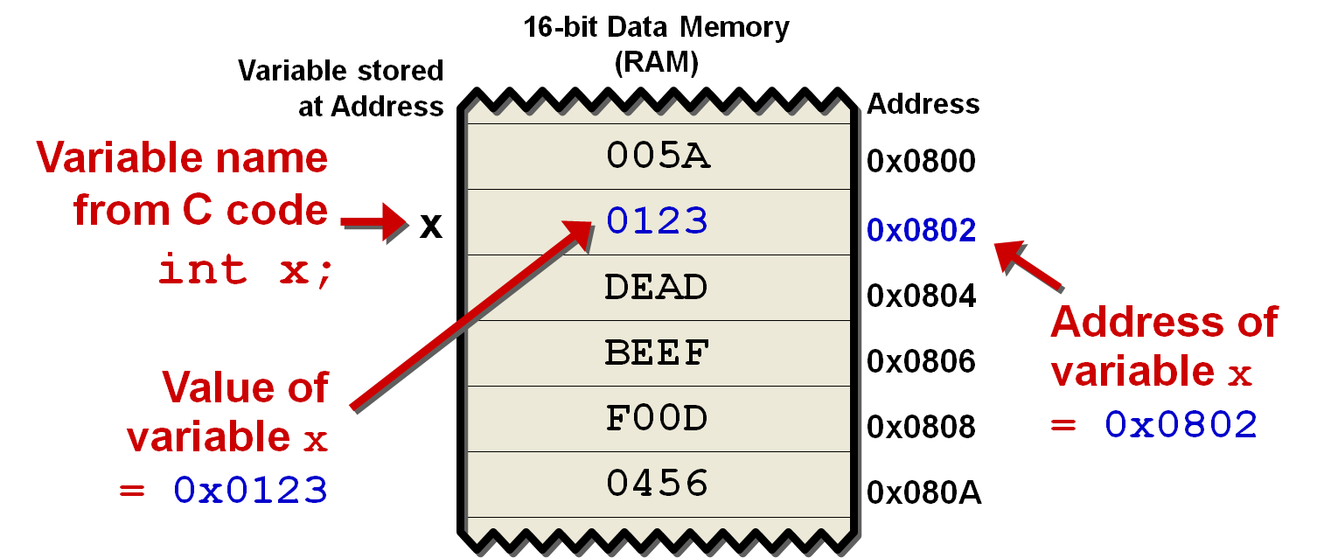
What is POINTER !!?

Slide 7
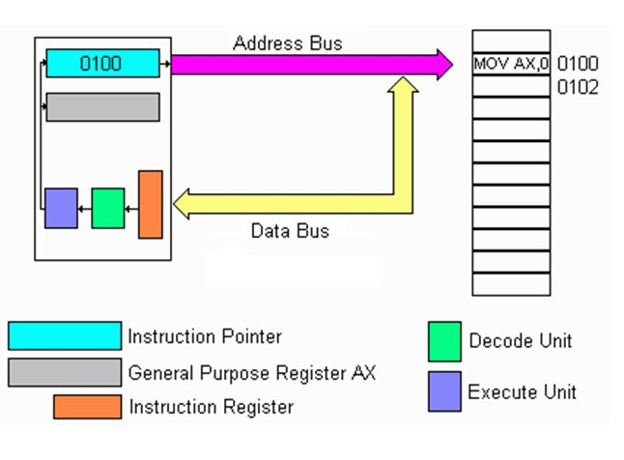
Instruction Pointer IP

Slide 8
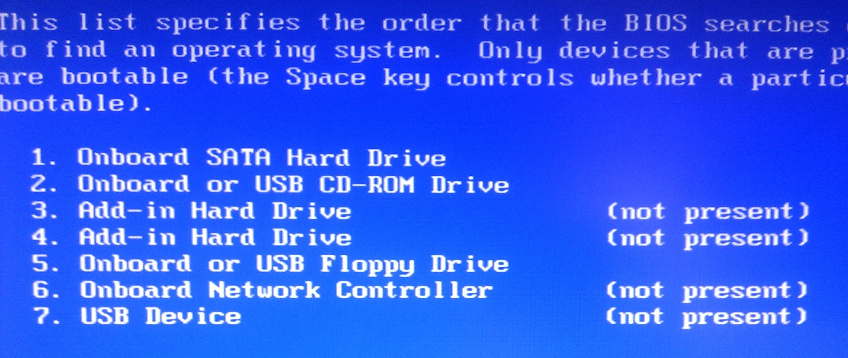
Finding an OS “INT 0x19”
Notes:
One of many things that the BIOS dose is creating It creates an Interrupt Vector Table (IVT), and provides some basic interrupt services, does some more tests to insure there is no hardware problems. The BIOS also supplies a Setup utility.
An interrupt: A signal informing a program that an event has occurred. When a program receives an interrupt signal, it takes a specified action (which can be to ignore the signal). Interrupt signals can cause a program to suspend itself temporarily to service the interrupt.
A signal that stalls everything else until it is complet

Slide 9
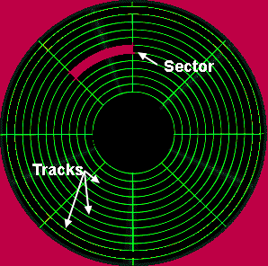
BOOTLOADER is the code that resides at the MBR
Master Boot Record “MBR”
A "Sector" simply represents a goupe of 512 bytes. So, Sector 1 represents the first 512 bytes of a disk.
A device is bootable if it carries a boot sector “MBR” with the byte sequence 0x55, 0xAA in bytes 511 and 512 respectively
If the disk is bootable, Then the bootsector will be loaded at 0x7C00, and INT 0x19 will jump to it, therby giving control to the bootloader
Then the bootloader loads the OS kernel

Slide 10
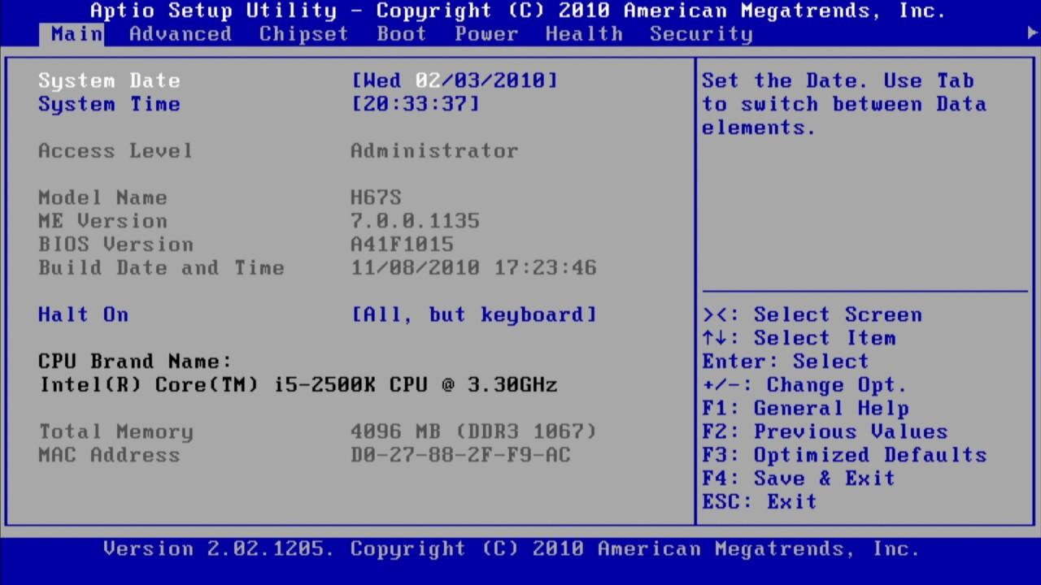
CMOS Setup

Slide 11
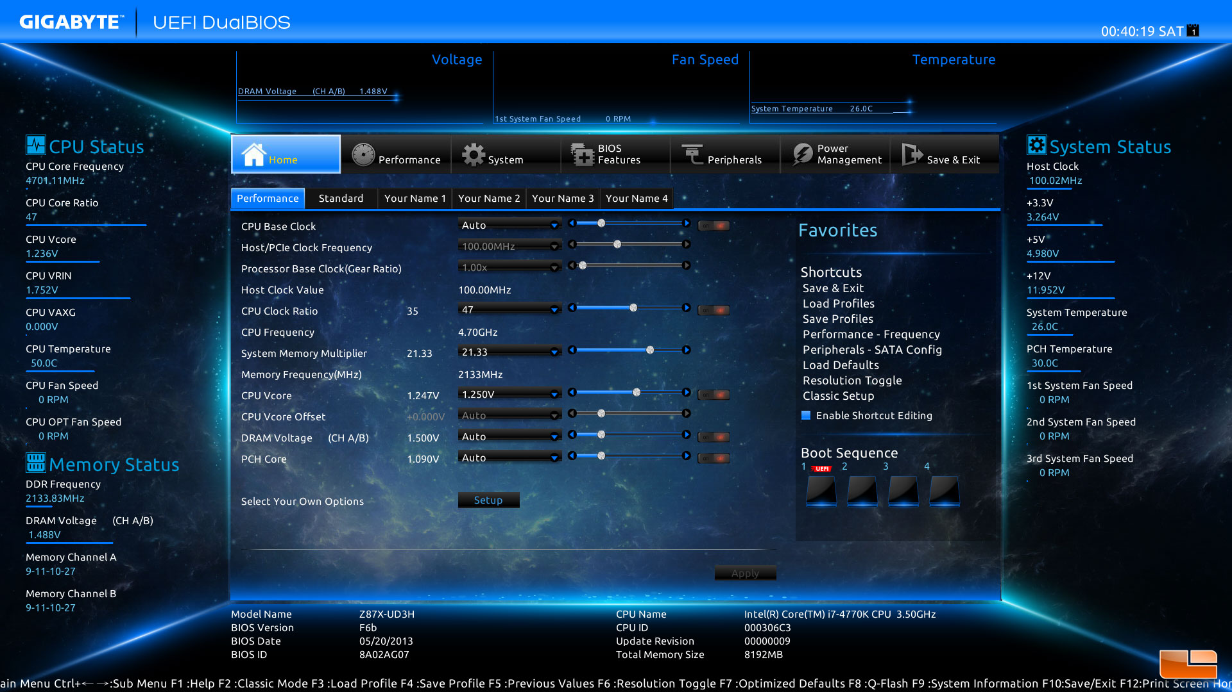

Unified Extensible Firmware Interface “UEFI”
Notes:
UEFI is the advanced version of legacy mode(BIOS) which is faster to resume the windows/Linux from hibernate and take less time to start. All 64-bit versions of computers running Windows with a logo from the Windows Certification Program will use UEFI in place of BIOS.

Slide 12
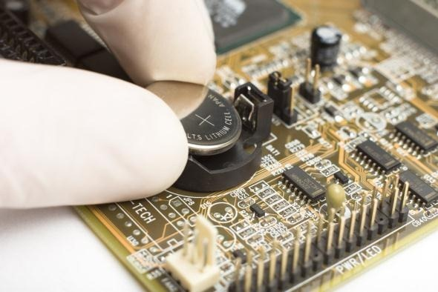
Why Does My Motherboard Have A Battery?

Slide 13
Report “the shell”
The shell is a program that takes your commands from the keyboard and gives them to the operating system to perform. In the old days, it was the only user interface available on a Unix and Linux computer. Nowadays, we have graphical user interfaces (GUIs) in addition to command line interfaces (CLIs) such as the shell.
omar.shaaban@live.co.uk

Slide 14
References
http://www.brokenthorn.com/Resources/OSDevIndex.html
http://www.makeuseof.com/tag/why-does-my-motherboard-have-a-battery/
https://www.youtube.com/watch?v=mHB0Z-HUauo
https://www.youtube.com/watch?v=SlzwMKcCoMI
https://0xax.gitbooks.io/linux-insides/content/Booting/index.html
https://www.youtube.com/playlist?list=PLfciLKR3SgqNJKKIKUliWoNBBH1VHL3AP

